Slide 1
Chapter 12 - Graphical User Interface Components: Part 1
Outline
12.1 Introduction
12.2 Swing Overview
12.3 JLabel
12.4 Event-Handling Model
12.5 JTextField and JPasswordField
12.5.1 How Event Handling Works
12.6 JButton
12.7 JCheckBox and JRadioButton
12.8 JComboBox
12.9 JList
12.10 Multiple-Selection Lists
12.11 Mouse Event Handling
12.12 Adapter Classes
12.13 Keyboard Event Handling
12.14 Layout Managers
12.14.1 FlowLayout
12.14.2 BorderLayout
12.14.3 GridLayout

Slide 2
Chapter 12 - Graphical User Interface Components: Part 1
12.15 Panels
12.16 (Optional Case Study) Thinking About Objects: Use Cases

Slide 3
12.1 Introduction
Graphical User Interface (GUI)
  Gives program distinctive “look” and “feel”
  Provides users with basic level of familiarity
  Built from GUI components (controls, widgets, etc.)
    User interacts with GUI component via mouse, keyboard, etc.

Slide 4

Fig. 12.1 A sample Netscape Navigator windows with GUI components.
    (Netscape Communicator browser window© 1999 Netscape Communications Corporation. Used with permission. Netscape Communications has not authorized, sponsored, endorsed, or approved this publication and is not responsible for its content.)

Slide 5
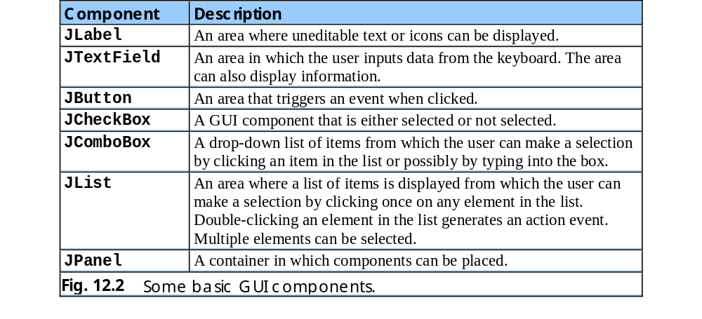
Fig. 12.2 Some basic GUI components.

Slide 6
12.2 Swing Overview
Swing GUI components
  Package javax.swing
  Components originate from AWT (package java.awt)
  Contain look and feel
    Appearance and how users interact with program
  Lightweight components
    Written completely in Java

Slide 7
12.2 Swing Overview (cont.)
Class Component
  Contains method paint for drawing Component onscreen
Class Container
  Collection of related components
  Contains method add for adding components
Class JComponent
  Pluggable look and feel for customizing look and feel
  Shortcut keys (mnemonics)
  Common event-handling capabilities

Slide 8
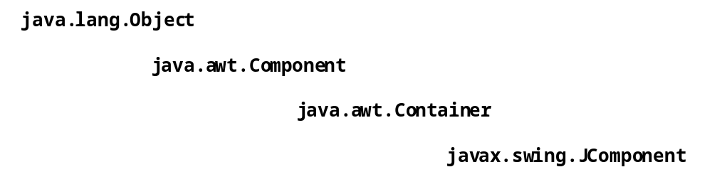
Fig. 12.3 Common superclasses of many of the Swing components.

Slide 9
12.3 JLabel
Label
  Provide text on GUI
  Defined with class JLabel
  Can display:
    Single line of read-only text
    Image
    Text and image

Slide 10
1 // Fig. 12.4: LabelTest.java
2 // Demonstrating the JLabel class.
3
4 // Java core packages
5 import java.awt.*;
6 import java.awt.event.*;
7
8 // Java extension packages
9 import javax.swing.*;
10
11 public class LabelTest extends JFrame {
12 private JLabel label1, label2, label3;
13
14 // set up GUI
15 public LabelTest()
16 {
17 super( "Testing JLabel" );
18
19 // get content pane and set its layout
20 Container container = getContentPane();
21 container.setLayout( new FlowLayout() );
22
23 // JLabel constructor with a string argument
24 label1 = new JLabel( "Label with text" );
25 label1.setToolTipText( "This is label1" );
26 container.add( label1 );
27
28 // JLabel constructor with string, Icon and
29 // alignment arguments
30 Icon bug = new ImageIcon( "bug1.gif" );
31 label2 = new JLabel( "Label with text and icon",
32 bug, SwingConstants.LEFT );
33 label2.setToolTipText( "This is label2" );
34 container.add( label2 );
35
LabelTest.java
Line 12
Line 24
Line 25
Lines 31-32
Declare three JLabels
Create first JLabel with text “Label with text”
Tool tip is text that appears when user moves cursor over JLabel
Create second JLabel with text to left of image

Slide 11
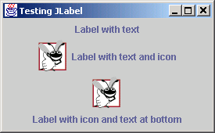
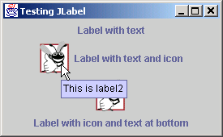
36 // JLabel constructor no arguments
37 label3 = new JLabel();
38 label3.setText( "Label with icon and text at bottom" );
39 label3.setIcon( bug );
40 label3.setHorizontalTextPosition( SwingConstants.CENTER );
41 label3.setVerticalTextPosition( SwingConstants.BOTTOM );
42 label3.setToolTipText( "This is label3" );
43 container.add( label3 );
44
45 setSize( 275, 170 );
46 setVisible( true );
47 }
48
49 // execute application
50 public static void main( String args[] )
51 {
52 LabelTest application = new LabelTest();
53
54 application.setDefaultCloseOperation(
55 JFrame.EXIT_ON_CLOSE );
56 }
57
58 } // end class LabelTest
Create third JLabel with text below image
LabelTest.java
Lines 37-41

Slide 12
12.4 Event-Handling Model
GUIs are event driven
  Generate events when user interacts with GUI
    e.g., moving mouse, pressing button, typing in text field, etc.
    Class java.awt.AWTEvent

Slide 13
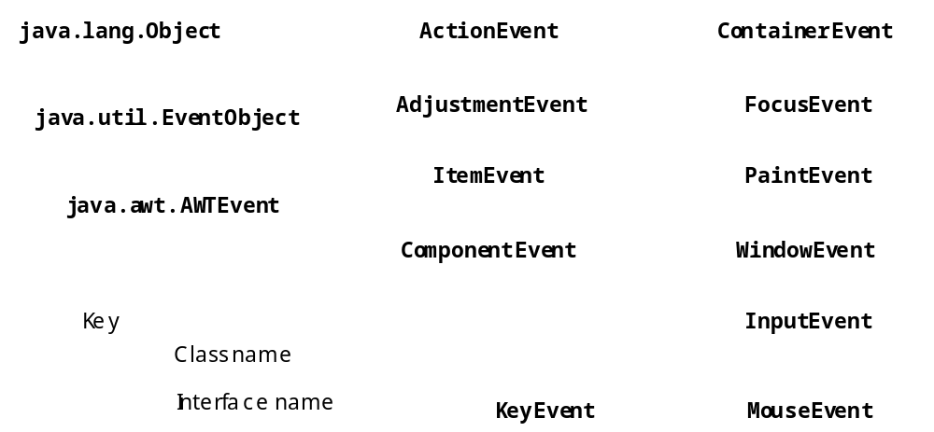
Fig. 12.5 Some event classes of package java.awt.event

Slide 14
12.4 Event-Handling Model (cont.)
Event-handling model
  Three parts
    Event source
      GUI component with which user interacts
    Event object
      Encapsulates information about event that occurred
    Event listener
      Receives event object when notified, then responds
  Programmer must perform two tasks
    Register event listener for event source
    Implement event-handling method (event handler)

Slide 15
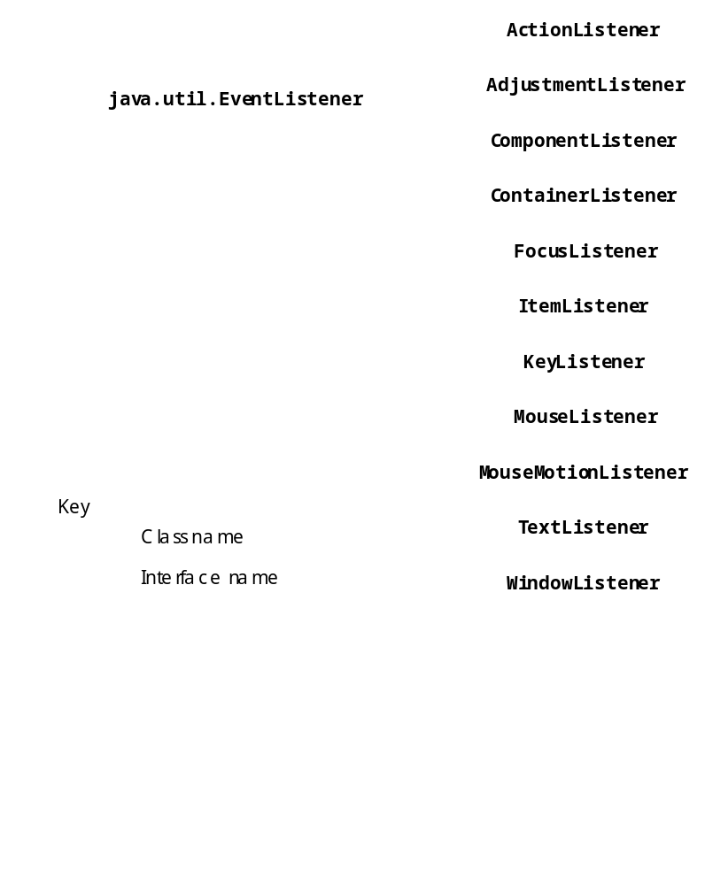
Fig. 12.6 Event-listener interfaces of package java.awt.event

Slide 16
12.5 JTextField and JPasswordField
JTextField
  Single-line area in which user can enter text
JPasswordField
  Extends JTextField
  Hides characters that user enters

Slide 17
1 // Fig. 12.7: TextFieldTest.java
2 // Demonstrating the JTextField class.
3
4 // Java core packages
5 import java.awt.*;
6 import java.awt.event.*;
7
8 // Java extension packages
9 import javax.swing.*;
10
11 public class TextFieldTest extends JFrame {
12 private JTextField textField1, textField2, textField3;
13 private JPasswordField passwordField;
14
15 // set up GUI
16 public TextFieldTest()
17 {
18 super( "Testing JTextField and JPasswordField" );
19
20 Container container = getContentPane();
21 container.setLayout( new FlowLayout() );
22
23 // construct textfield with default sizing
24 textField1 = new JTextField( 10 );
25 container.add( textField1 );
26
27 // construct textfield with default text
28 textField2 = new JTextField( "Enter text here" );
29 container.add( textField2 );
30
31 // construct textfield with default text and
32 // 20 visible elements and no event handler
33 textField3 = new JTextField( "Uneditable text field", 20 );
34 textField3.setEditable( false );
35 container.add( textField3 );
TextFieldTest.java
Lines 12-13
Line 24
Line 28
Lines 33-34
Declare three JTextFields and one JPasswordField
First JTextField contains empty string
Second JTextField contains text “Enter text here”
Third JTextField contains uneditable text

Slide 18
36
37 // construct textfield with default text
38 passwordField = new JPasswordField( "Hidden text" );
39 container.add( passwordField );
40
41 // register event handlers
42 TextFieldHandler handler = new TextFieldHandler();
43 textField1.addActionListener( handler );
44 textField2.addActionListener( handler );
45 textField3.addActionListener( handler );
46 passwordField.addActionListener( handler );
47
48 setSize( 325, 100 );
49 setVisible( true );
50 }
51
52 // execute application
53 public static void main( String args[] )
54 {
55 TextFieldTest application = new TextFieldTest();
56
57 application.setDefaultCloseOperation(
58 JFrame.EXIT_ON_CLOSE );
59 }
60
61 // private inner class for event handling
62 private class TextFieldHandler implements ActionListener {
63
64 // process text field events
65 public void actionPerformed( ActionEvent event )
66 {
67 String string = "";
68
69 // user pressed Enter in JTextField textField1
70 if ( event.getSource() == textField1 )
JPasswordField contains text “Hidden text,” but text appears as series of asterisks (*)
TextFieldTest.java
Line 38
Lines 43-46
Line 62
Line 65
Register GUI components with TextFieldHandler (register for ActionEvents)
Every TextFieldHandler instance is an ActionListener
Method actionPerformed invoked when user presses Enter in GUI field

Slide 19
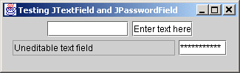
71 string = "textField1: " + event.getActionCommand();
72
73 // user pressed Enter in JTextField textField2
74 else if ( event.getSource() == textField2 )
75 string = "textField2: " + event.getActionCommand();
76
77 // user pressed Enter in JTextField textField3
78 else if ( event.getSource() == textField3 )
79 string = "textField3: " + event.getActionCommand();
80
81 // user pressed Enter in JTextField passwordField
82 else if ( event.getSource() == passwordField ) {
83 JPasswordField pwd =
84 ( JPasswordField ) event.getSource();
85 string = "passwordField: " +
86 new String( passwordField.getPassword() );
87 }
88
89 JOptionPane.showMessageDialog( null, string );
90 }
91
92 } // end private inner class TextFieldHandler
93
94 } // end class TextFieldTest
TextFieldTest.java

Slide 20
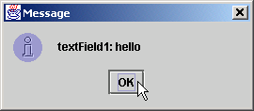
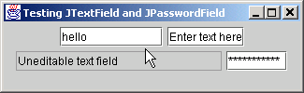
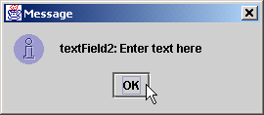
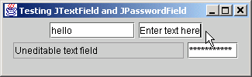
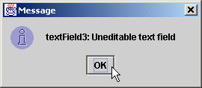

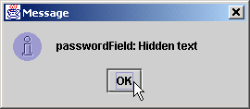
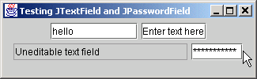
TextFieldTest.java

Slide 21
12.5.1 How Event Handling Works
Two open questions from Section 12.4
  How did event handler get registered?
    Answer:
      Through component’s method addActionListener
      Lines 43-46 of TextFieldTest.java
  How does component know to call actionPerformed?
    Answer:
      Event is dispatched only to listeners of appropriate type
      Each event type has corresponding event-listener interface
        Event ID specifies event type that occurred

Slide 22
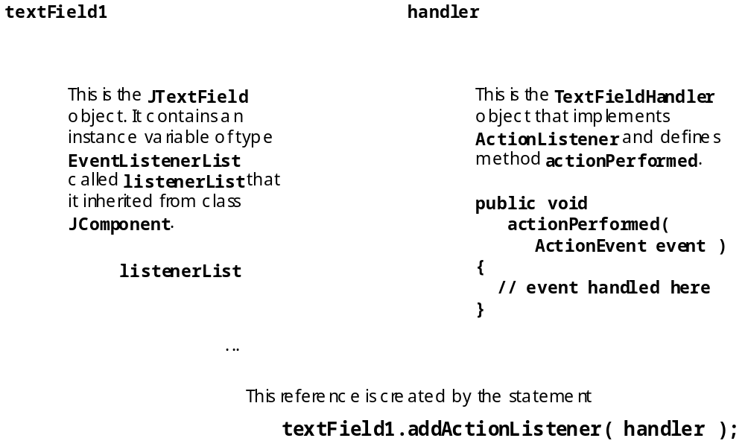
Fig 12.8 Event registration for JTextField textField1.

Slide 23
12.6 JButton
Button
  Component user clicks to trigger a specific action
  Several different types
    Command buttons
    Check boxes
    Toggle buttons
    Radio buttons
  javax.swing.AbstractButton subclasses
    Command buttons are created with class JButton
      Generate ActionEvents when user clicks button

Slide 24
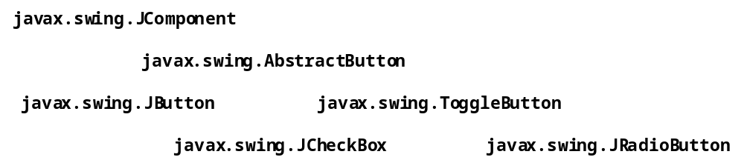
Fig. 12.9 The button heirarchy.

Slide 25
1 // Fig. 12.10: ButtonTest.java
2 // Creating JButtons.
3
4 // Java core packages
5 import java.awt.*;
6 import java.awt.event.*;
7
8 // Java extension packages
9 import javax.swing.*;
10
11 public class ButtonTest extends JFrame {
12 private JButton plainButton, fancyButton;
13
14 // set up GUI
15 public ButtonTest()
16 {
17 super( "Testing Buttons" );
18
19 // get content pane and set its layout
20 Container container = getContentPane();
21 container.setLayout( new FlowLayout() );
22
23 // create buttons
24 plainButton = new JButton( "Plain Button" );
25 container.add( plainButton );
26
27 Icon bug1 = new ImageIcon( "bug1.gif" );
28 Icon bug2 = new ImageIcon( "bug2.gif" );
29 fancyButton = new JButton( "Fancy Button", bug1 );
30 fancyButton.setRolloverIcon( bug2 );
31 container.add( fancyButton );
32
33 // create an instance of inner class ButtonHandler
34 // to use for button event handling
35 ButtonHandler handler = new ButtonHandler();
ButtonTest.java
Line 12
Line 24
Lines 27-30
Line 35
Create two references to JButton instances
Instantiate JButton with text
Instantiate JButton with image and rollover image
Instantiate ButtonHandler for JButton event handling

Slide 26
36 fancyButton.addActionListener( handler );
37 plainButton.addActionListener( handler );
38
39 setSize( 275, 100 );
40 setVisible( true );
41 }
42
43 // execute application
44 public static void main( String args[] )
45 {
46 ButtonTest application = new ButtonTest();
47
48 application.setDefaultCloseOperation(
49 JFrame.EXIT_ON_CLOSE );
50 }
51
52 // inner class for button event handling
53 private class ButtonHandler implements ActionListener {
54
55 // handle button event
56 public void actionPerformed( ActionEvent event )
57 {
58 JOptionPane.showMessageDialog( null,
59 "You pressed: " + event.getActionCommand() );
60 }
61
62 } // end private inner class ButtonHandler
63
64 } // end class ButtonTest
Register JButtons to receive events from ButtonHandler
ButtonTest.java
Lines 36-37
Lines 56-60
When user clicks JButton, ButtonHandler invokes method actionPerformed of all registered listeners

Slide 27
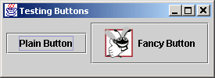
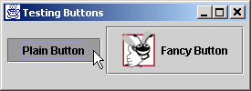

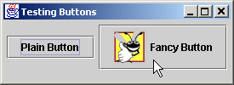
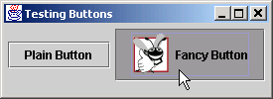
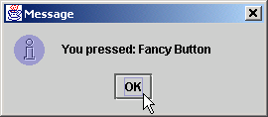
ButtonTest.java

Slide 28
12.7 JCheckBox and JRadioButton
State buttons
  On/Off or true/false values
  Java provides three types
    JToggleButton
    JCheckBox
    JRadioButton

Slide 29
1 // Fig. 12.11: CheckBoxTest.java
2 // Creating Checkbox buttons.
3
4 // Java core packages
5 import java.awt.*;
6 import java.awt.event.*;
7
8 // Java extension packages
9 import javax.swing.*;
10
11 public class CheckBoxTest extends JFrame {
12 private JTextField field;
13 private JCheckBox bold, italic;
14
15 // set up GUI
16 public CheckBoxTest()
17 {
18 super( "JCheckBox Test" );
19
20 // get content pane and set its layout
21 Container container = getContentPane();
22 container.setLayout( new FlowLayout() );
23
24 // set up JTextField and set its font
25 field =
26 new JTextField( "Watch the font style change", 20 );
27 field.setFont( new Font( "Serif", Font.PLAIN, 14 ) );
28 container.add( field );
29
30 // create checkbox objects
31 bold = new JCheckBox( "Bold" );
32 container.add( bold );
33
34 italic = new JCheckBox( "Italic" );
35 container.add( italic );
CheckBoxTest.java
Line 13
Line 27
Lines 31-35
Declare two JCheckBox instances
Set JTextField font to Serif, 14-point plain
Instantiate JCheckBoxs for bolding and italicizing JTextField text, respectively

Slide 30
36
37 // register listeners for JCheckBoxes
38 CheckBoxHandler handler = new CheckBoxHandler();
39 bold.addItemListener( handler );
40 italic.addItemListener( handler );
41
42 setSize( 275, 100 );
43 setVisible( true );
44 }
45
46 // execute application
47 public static void main( String args[] )
48 {
49 CheckBoxTest application = new CheckBoxTest();
50
51 application.setDefaultCloseOperation(
52 JFrame.EXIT_ON_CLOSE );
53 }
54
55 // private inner class for ItemListener event handling
56 private class CheckBoxHandler implements ItemListener {
57 private int valBold = Font.PLAIN;
58 private int valItalic = Font.PLAIN;
59
60 // respond to checkbox events
61 public void itemStateChanged( ItemEvent event )
62 {
63 // process bold checkbox events
64 if ( event.getSource() == bold )
65
66 if ( event.getStateChange() == ItemEvent.SELECTED )
67 valBold = Font.BOLD;
68 else
69 valBold = Font.PLAIN;
70
Register JCheckBoxs to receive events from CheckBoxHandler
CheckBoxTest.java
Lines 38-40
Line 61
When user selects JCheckBox, CheckBoxHandler invokes method itemStateChanges of all registered listeners

Slide 31
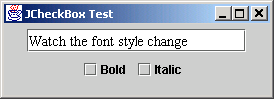
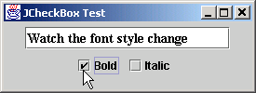
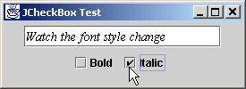
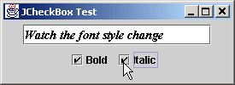
71 // process italic checkbox events
72 if ( event.getSource() == italic )
73
74 if ( event.getStateChange() == ItemEvent.SELECTED )
75 valItalic = Font.ITALIC;
76 else
77 valItalic = Font.PLAIN;
78
79 // set text field font
80 field.setFont(
81 new Font( "Serif", valBold + valItalic, 14 ) );
82 }
83
84 } // end private inner class CheckBoxHandler
85
86 } // end class CheckBoxTest
CheckBoxTest.java
Lines 80-81
Change JTextField font, depending on which JCheckBox was selected

Slide 32
1 // Fig. 12.12: RadioButtonTest.java
2 // Creating radio buttons using ButtonGroup and JRadioButton.
3
4 // Java core packages
5 import java.awt.*;
6 import java.awt.event.*;
7
8 // Java extension packages
9 import javax.swing.*;
10
11 public class RadioButtonTest extends JFrame {
12 private JTextField field;
13 private Font plainFont, boldFont, italicFont, boldItalicFont;
14 private JRadioButton plainButton, boldButton, italicButton,
15 boldItalicButton;
16 private ButtonGroup radioGroup;
17
18 // create GUI and fonts
19 public RadioButtonTest()
20 {
21 super( "RadioButton Test" );
22
23 // get content pane and set its layout
24 Container container = getContentPane();
25 container.setLayout( new FlowLayout() );
26
27 // set up JTextField
28 field =
29 new JTextField( "Watch the font style change", 25 );
30 container.add( field );
31
32 // create radio buttons
33 plainButton = new JRadioButton( "Plain", true );
34 container.add( plainButton );
35
RadioButtonTest.java
Lines 14-15
Line 16
Declare four JRadioButton instances
JRadioButtons normally appear as a ButtonGroup

Slide 33
36 boldButton = new JRadioButton( "Bold", false);
37 container.add( boldButton );
38
39 italicButton = new JRadioButton( "Italic", false );
40 container.add( italicButton );
41
42 boldItalicButton = new JRadioButton(
43 "Bold/Italic", false );
44 container.add( boldItalicButton );
45
46 // register events for JRadioButtons
47 RadioButtonHandler handler = new RadioButtonHandler();
48 plainButton.addItemListener( handler );
49 boldButton.addItemListener( handler );
50 italicButton.addItemListener( handler );
51 boldItalicButton.addItemListener( handler );
52
53 // create logical relationship between JRadioButtons
54 radioGroup = new ButtonGroup();
55 radioGroup.add( plainButton );
56 radioGroup.add( boldButton );
57 radioGroup.add( italicButton );
58 radioGroup.add( boldItalicButton );
59
60 // create font objects
61 plainFont = new Font( "Serif", Font.PLAIN, 14 );
62 boldFont = new Font( "Serif", Font.BOLD, 14 );
63 italicFont = new Font( "Serif", Font.ITALIC, 14 );
64 boldItalicFont =
65 new Font( "Serif", Font.BOLD + Font.ITALIC, 14 );
66 field.setFont( plainFont );
67
68 setSize( 300, 100 );
69 setVisible( true );
70 }
RadioButtonTest.java
Lines 36-44
Lines 47-51
Lines 54-58
Instantiate JRadioButtons for manipulating JTextField text font
Register JRadioButtons to receive events from RadioButtonHandler
JRadioButtons belong to ButtonGroup

Slide 34
71
72 // execute application
73 public static void main( String args[] )
74 {
75 RadioButtonTest application = new RadioButtonTest();
76
77 application.setDefaultCloseOperation(
78 JFrame.EXIT_ON_CLOSE );
79 }
80
81 // private inner class to handle radio button events
82 private class RadioButtonHandler implements ItemListener {
83
84 // handle radio button events
85 public void itemStateChanged( ItemEvent event )
86 {
87 // user clicked plainButton
88 if ( event.getSource() == plainButton )
89 field.setFont( plainFont );
90
91 // user clicked boldButton
92 else if ( event.getSource() == boldButton )
93 field.setFont( boldFont );
94
95 // user clicked italicButton
96 else if ( event.getSource() == italicButton )
97 field.setFont( italicFont );
98
99 // user clicked boldItalicButton
100 else if ( event.getSource() == boldItalicButton )
101 field.setFont( boldItalicFont );
102 }
103
104 } // end private inner class RadioButtonHandler
105
106 } // end class RadioButtonTest
RadioButtonTest.java
Lines 85-104
Lines 88-102
When user selects JRadioButton, RadioButtonHandler invokes method itemStateChanged of all registered listeners
Set font corresponding to JRadioButton selected

Slide 35
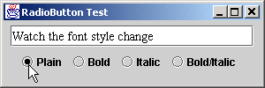
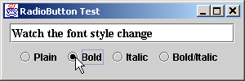
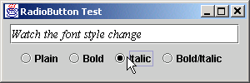
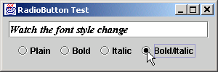
RadioButtonTest.java

Slide 36
12.8 JComboBox
JComboBox
  List of items from which user can select
  Also called a drop-down list

Slide 37
1 // Fig. 12.13: ComboBoxTest.java
2 // Using a JComboBox to select an image to display.
3
4 // Java core packages
5 import java.awt.*;
6 import java.awt.event.*;
7
8 // Java extension packages
9 import javax.swing.*;
10
11 public class ComboBoxTest extends JFrame {
12 private JComboBox imagesComboBox;
13 private JLabel label;
14
15 private String names[] =
16 { "bug1.gif", "bug2.gif", "travelbug.gif", "buganim.gif" };
17 private Icon icons[] = { new ImageIcon( names[ 0 ] ),
18 new ImageIcon( names[ 1 ] ), new ImageIcon( names[ 2 ] ),
19 new ImageIcon( names[ 3 ] ) };
20
21 // set up GUI
22 public ComboBoxTest()
23 {
24 super( "Testing JComboBox" );
25
26 // get content pane and set its layout
27 Container container = getContentPane();
28 container.setLayout( new FlowLayout() );
29
30 // set up JComboBox and register its event handler
31 imagesComboBox = new JComboBox( names );
32 imagesComboBox.setMaximumRowCount( 3 );
33
34 imagesComboBox.addItemListener(
35
ComboBoxTest.java
Lines 31-32
Line 34
Instantiate JComboBox to show three Strings from names array at a time
Register JComboBox to receive events from anonymous ItemListener

Slide 38
36 // anonymous inner class to handle JComboBox events
37 new ItemListener() {
38
39 // handle JComboBox event
40 public void itemStateChanged( ItemEvent event )
41 {
42 // determine whether check box selected
43 if ( event.getStateChange() == ItemEvent.SELECTED )
44 label.setIcon( icons[
45 imagesComboBox.getSelectedIndex() ] );
46 }
47
48 } // end anonymous inner class
49
50 ); // end call to addItemListener
51
52 container.add( imagesComboBox );
53
54 // set up JLabel to display ImageIcons
55 label = new JLabel( icons[ 0 ] );
56 container.add( label );
57
58 setSize( 350, 100 );
59 setVisible( true );
60 }
61
62 // execute application
63 public static void main( String args[] )
64 {
65 ComboBoxTest application = new ComboBoxTest();
66
67 application.setDefaultCloseOperation(
68 JFrame.EXIT_ON_CLOSE );
69 }
70
71 } // end class ComboBoxTest
ComboBoxTest.java
Lines 40-46
Lines 43-45
When user selects item in JComboBox, ItemListener invokes method itemStateChanged of all registered listeners
Set appropriate Icon depending on user selection

Slide 39
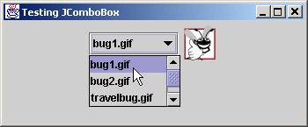
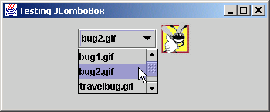
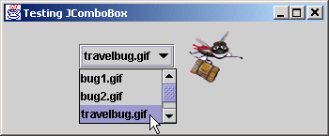
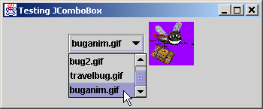
ComboBoxTest.java

Slide 40
12.9 JList
List
  Series of items
  user can select one or more items
  Single-selection vs. multiple-selection
  JList

Slide 41
1 // Fig. 12.14: ListTest.java
2 // Selecting colors from a JList.
3
4 // Java core packages
5 import java.awt.*;
6
7 // Java extension packages
8 import javax.swing.*;
9 import javax.swing.event.*;
10
11 public class ListTest extends JFrame {
12 private JList colorList;
13 private Container container;
14
15 private String colorNames[] = { "Black", "Blue", "Cyan",
16 "Dark Gray", "Gray", "Green", "Light Gray", "Magenta",
17 "Orange", "Pink", "Red", "White", "Yellow" };
18
19 private Color colors[] = { Color.black, Color.blue,
20 Color.cyan, Color.darkGray, Color.gray, Color.green,
21 Color.lightGray, Color.magenta, Color.orange, Color.pink,
22 Color.red, Color.white, Color.yellow };
23
24 // set up GUI
25 public ListTest()
26 {
27 super( "List Test" );
28
29 // get content pane and set its layout
30 container = getContentPane();
31 container.setLayout( new FlowLayout() );
32
33 // create a list with items in colorNames array
34 colorList = new JList( colorNames );
35 colorList.setVisibleRowCount( 5 );
ListTest.java
Line 34
Use colorNames array to populate JList

Slide 42
36
37 // do not allow multiple selections
38 colorList.setSelectionMode(
39 ListSelectionModel.SINGLE_SELECTION );
40
41 // add a JScrollPane containing JList to content pane
42 container.add( new JScrollPane( colorList ) );
43
44 // set up event handler
45 colorList.addListSelectionListener(
46
47 // anonymous inner class for list selection events
48 new ListSelectionListener() {
49
50 // handle list selection events
51 public void valueChanged( ListSelectionEvent event )
52 {
53 container.setBackground(
54 colors[ colorList.getSelectedIndex() ] );
55 }
56
57 } // end anonymous inner class
58
59 ); // end call to addListSelectionListener
60
61 setSize( 350, 150 );
62 setVisible( true );
63 }
64
65 // execute application
66 public static void main( String args[] )
67 {
68 ListTest application = new ListTest();
69
JList allows single selections
ListTest.java
Lines 38-39
Lines 45-59
Lines 51-55
Lines 53-54
Register JList to receive events from anonymous ListSelectionListener
When user selects item in JList, ListSelectionListener invokes method valueChanged of all registered listeners
Set appropriate background depending on user selection

Slide 43
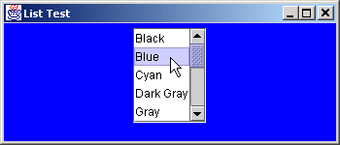
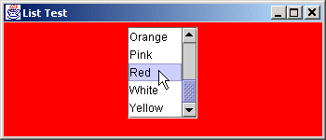
70 application.setDefaultCloseOperation(
71 JFrame.EXIT_ON_CLOSE );
72 }
73
74 } // end class ListTest
ListTest.java

Slide 44
12.10 Multiple-Selection Lists
Multiple-selection list
  Select many items from Jlist
  Allows continuous range selection

Slide 45
1 // Fig. 12.15: MultipleSelection.java
2 // Copying items from one List to another.
3
4 // Java core packages
5 import java.awt.*;
6 import java.awt.event.*;
7
8 // Java extension packages
9 import javax.swing.*;
10
11 public class MultipleSelection extends JFrame {
12 private JList colorList, copyList;
13 private JButton copyButton;
14
15 private String colorNames[] = { "Black", "Blue", "Cyan",
16 "Dark Gray", "Gray", "Green", "Light Gray",
17 "Magenta", "Orange", "Pink", "Red", "White", "Yellow" };
18
19 // set up GUI
20 public MultipleSelection()
21 {
22 super( "Multiple Selection Lists" );
23
24 // get content pane and set its layout
25 Container container = getContentPane();
26 container.setLayout( new FlowLayout() );
27
28 // set up JList colorList
29 colorList = new JList( colorNames );
30 colorList.setVisibleRowCount( 5 );
31 colorList.setFixedCellHeight( 15 );
32 colorList.setSelectionMode(
33 ListSelectionModel.MULTIPLE_INTERVAL_SELECTION );
34 container.add( new JScrollPane( colorList ) );
35
MultipleSelection.java
Line 29
Lines 32-33
Use colorNames array to populate JList
JList colorList allows multiple selections

Slide 46
36 // create copy button and register its listener
37 copyButton = new JButton( "Copy >>>" );
38
39 copyButton.addActionListener(
40
41 // anonymous inner class for button event
42 new ActionListener() {
43
44 // handle button event
45 public void actionPerformed( ActionEvent event )
46 {
47 // place selected values in copyList
48 copyList.setListData(
49 colorList.getSelectedValues() );
50 }
51
52 } // end anonymous inner class
53
54 ); // end call to addActionListener
55
56 container.add( copyButton );
57
58 // set up JList copyList
59 copyList = new JList();
60 copyList.setVisibleRowCount( 5 );
61 copyList.setFixedCellWidth( 100 );
62 copyList.setFixedCellHeight( 15 );
63 copyList.setSelectionMode(
64 ListSelectionModel.SINGLE_INTERVAL_SELECTION );
65 container.add( new JScrollPane( copyList ) );
66
67 setSize( 300, 120 );
68 setVisible( true );
69 }
70
MultipleSelection.java
Lines 48-49
Lines 63-64
When user presses JButton, JList copyList adds items that user selected from JList colorList
JList colorList allows single selections

Slide 47
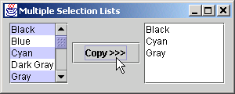
71 // execute application
72 public static void main( String args[] )
73 {
74 MultipleSelection application = new MultipleSelection();
75
76 application.setDefaultCloseOperation(
77 JFrame.EXIT_ON_CLOSE );
78 }
79
80 } // end class MultipleSelection
MultipleSelection.java

Slide 48
12.11 Mouse Event Handling
Event-listener interfaces for mouse events
  MouseListener
  MouseMotionListener
  Listen for MouseEvents

Slide 49
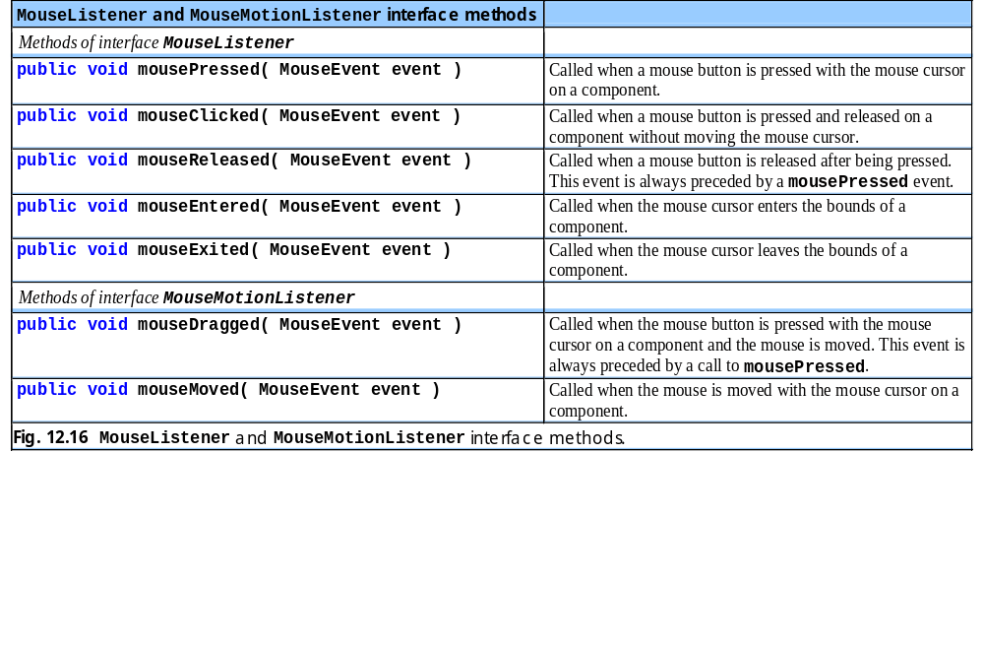
Fig. 12.16 MouseListener and MouseMotionListener interface methods

Slide 50
1 // Fig. 12.17: MouseTracker.java
2 // Demonstrating mouse events.
3
4 // Java core packages
5 import java.awt.*;
6 import java.awt.event.*;
7
8 // Java extension packages
9 import javax.swing.*;
10
11 public class MouseTracker extends JFrame
12 implements MouseListener, MouseMotionListener {
13
14 private JLabel statusBar;
15
16 // set up GUI and register mouse event handlers
17 public MouseTracker()
18 {
19 super( "Demonstrating Mouse Events" );
20
21 statusBar = new JLabel();
22 getContentPane().add( statusBar, BorderLayout.SOUTH );
23
24 // application listens to its own mouse events
25 addMouseListener( this );
26 addMouseMotionListener( this );
27
28 setSize( 275, 100 );
29 setVisible( true );
30 }
31
32 // MouseListener event handlers
33
34 // handle event when mouse released immediately after press
35 public void mouseClicked( MouseEvent event )
MouseTracker.java
Lines 25-26
Line 35
Register JFrame to receive mouse events
Invoked when user presses and releases mouse button

Slide 51
36 {
37 statusBar.setText( "Clicked at [" + event.getX() +
38 ", " + event.getY() + "]" );
39 }
40
41 // handle event when mouse pressed
42 public void mousePressed( MouseEvent event )
43 {
44 statusBar.setText( "Pressed at [" + event.getX() +
45 ", " + event.getY() + "]" );
46 }
47
48 // handle event when mouse released after dragging
49 public void mouseReleased( MouseEvent event )
50 {
51 statusBar.setText( "Released at [" + event.getX() +
52 ", " + event.getY() + "]" );
53 }
54
55 // handle event when mouse enters area
56 public void mouseEntered( MouseEvent event )
57 {
58 JOptionPane.showMessageDialog( null, "Mouse in window" );
59 }
60
61 // handle event when mouse exits area
62 public void mouseExited( MouseEvent event )
63 {
64 statusBar.setText( "Mouse outside window" );
65 }
66
67 // MouseMotionListener event handlers
68
69 // handle event when user drags mouse with button pressed
70 public void mouseDragged( MouseEvent event )
MouseTracker.java
Line 42
Line 49
Line 56
Line 62
Line 70
Invoked when user presses mouse button
Invoked when user releases mouse button after dragging mouse
Invoked when mouse cursor enters JFrame
Invoked when mouse cursor exits JFrame
Invoked when user drags mouse cursor

Slide 52
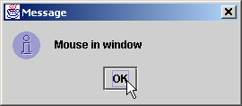
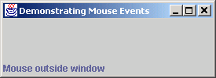
71 {
72 statusBar.setText( "Dragged at [" + event.getX() +
73 ", " + event.getY() + "]" );
74 }
75
76 // handle event when user moves mouse
77 public void mouseMoved( MouseEvent event )
78 {
79 statusBar.setText( "Moved at [" + event.getX() +
80 ", " + event.getY() + "]" );
81 }
82
83 // execute application
84 public static void main( String args[] )
85 {
86 MouseTracker application = new MouseTracker();
87
88 application.setDefaultCloseOperation(
89 JFrame.EXIT_ON_CLOSE );
90 }
91
92 } // end class MouseTracker
MouseTracker.java
Line 77
Invoked when user moves mouse cursor

Slide 53
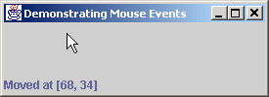
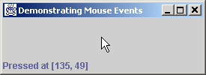
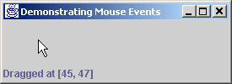
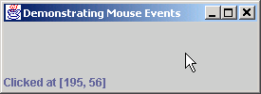
MouseTracker.java

Slide 54
12.12 Adapter Classes
Adapter class
  Implements interface
  Provides default implementation of each interface method
  Used when all methods in interface is not needed

Slide 55
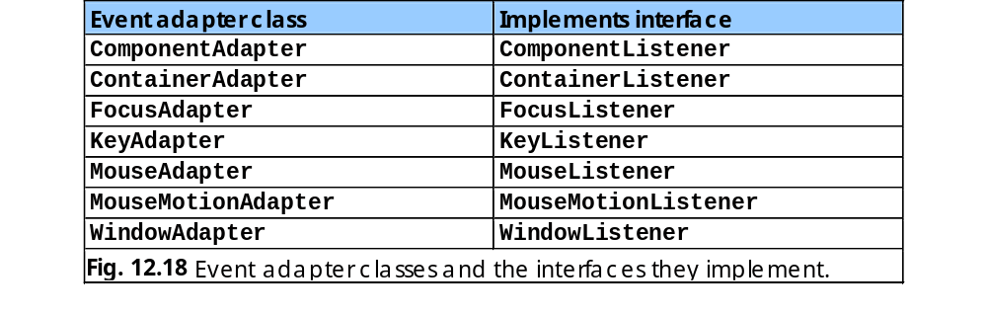
Fig. 12.18 Event adapter classes and the interfaces they implement.

Slide 56
1 // Fig. 12.19: Painter.java
2 // Using class MouseMotionAdapter.
3
4 // Java core packages
5 import java.awt.*;
6 import java.awt.event.*;
7
8 // Java extension packages
9 import javax.swing.*;
10
11 public class Painter extends JFrame {
12 private int xValue = -10, yValue = -10;
13
14 // set up GUI and register mouse event handler
15 public Painter()
16 {
17 super( "A simple paint program" );
18
19 // create a label and place it in SOUTH of BorderLayout
20 getContentPane().add(
21 new Label( "Drag the mouse to draw" ),
22 BorderLayout.SOUTH );
23
24 addMouseMotionListener(
25
26 // anonymous inner class
27 new MouseMotionAdapter() {
28
29 // store drag coordinates and repaint
30 public void mouseDragged( MouseEvent event )
31 {
32 xValue = event.getX();
33 yValue = event.getY();
34 repaint();
35 }
Painter.java
Line 24
Lines 30-35
Lines 32-34
Register MouseMotionListener to listen for window’s mouse-motion events
Override method mouseDragged, but not method mouseMoved
Store coordinates where mouse was dragged, then repaint JFrame

Slide 57
36
37 } // end anonymous inner class
38
39 ); // end call to addMouseMotionListener
40
41 setSize( 300, 150 );
42 setVisible( true );
43 }
44
45 // draw oval in a 4-by-4 bounding box at the specified
46 // location on the window
47 public void paint( Graphics g )
48 {
49 // we purposely did not call super.paint( g ) here to
50 // prevent repainting
51
52 g.fillOval( xValue, yValue, 4, 4 );
53 }
54
55 // execute application
56 public static void main( String args[] )
57 {
58 Painter application = new Painter();
59
60 application.addWindowListener(
61
62 // adapter to handle only windowClosing event
63 new WindowAdapter() {
64
65 public void windowClosing( WindowEvent event )
66 {
67 System.exit( 0 );
68 }
69
Painter.java
Line 52
Draw circle of diameter 4 where user dragged cursor

Slide 58
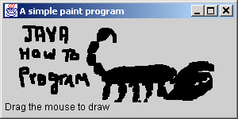
70 } // end anonymous inner class
71
72 ); // end call to addWindowListener
73 }
74
75 } // end class Painter
Painter.java

Slide 59
1 // Fig. 12.20: MouseDetails.java
2 // Demonstrating mouse clicks and
3 // distinguishing between mouse buttons.
4
5 // Java core packages
6 import java.awt.*;
7 import java.awt.event.*;
8
9 // Java extension packages
10 import javax.swing.*;
11
12 public class MouseDetails extends JFrame {
13 private int xPos, yPos;
14
15 // set title bar String, register mouse listener and size
16 // and show window
17 public MouseDetails()
18 {
19 super( "Mouse clicks and buttons" );
20
21 addMouseListener( new MouseClickHandler() );
22
23 setSize( 350, 150 );
24 setVisible( true );
25 }
26
27 // draw String at location where mouse was clicked
28 public void paint( Graphics g )
29 {
30 // call superclass's paint method
31 super.paint( g );
32
33 g.drawString( "Clicked @ [" + xPos + ", " + yPos + "]",
34 xPos, yPos );
35 }
MouseDetails.java
Line 21
Register mouse listener

Slide 60
36
37 // execute application
38 public static void main( String args[] )
39 {
40 MouseDetails application = new MouseDetails();
41
42 application.setDefaultCloseOperation(
43 JFrame.EXIT_ON_CLOSE );
44 }
45
46 // inner class to handle mouse events
47 private class MouseClickHandler extends MouseAdapter {
48
49 // handle mouse click event and determine which mouse
50 // button was pressed
51 public void mouseClicked( MouseEvent event )
52 {
53 xPos = event.getX();
54 yPos = event.getY();
55
56 String title =
57 "Clicked " + event.getClickCount() + " time(s)";
58
59 // right mouse button
60 if ( event.isMetaDown() )
61 title += " with right mouse button";
62
63 // middle mouse button
64 else if ( event.isAltDown() )
65 title += " with center mouse button";
66
67 // left mouse button
68 else
69 title += " with left mouse button";
MouseDetails.java
Line 51
Lines 53-54
Lines 56-57
Lines 60-61
Lines 64-65
Invoke method mouseClicked when user clicks mouse
Store mouse-cursor coordinates where mouse was clicked
Determine number of times user has clicked mouse
Determine if user clicked right mouse button
Determine if user clicked middle mouse button

Slide 61
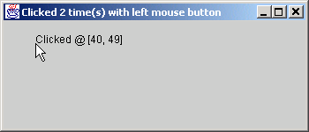
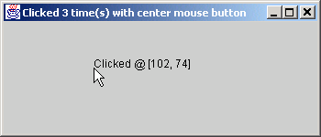
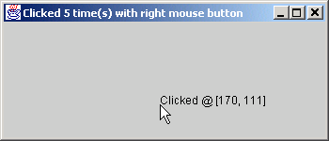
70
71 setTitle( title ); // set title bar of window
72 repaint();
73 }
74
75 } // end private inner class MouseClickHandler
76
77 } // end class MouseDetails
MouseDetails.java

Slide 62
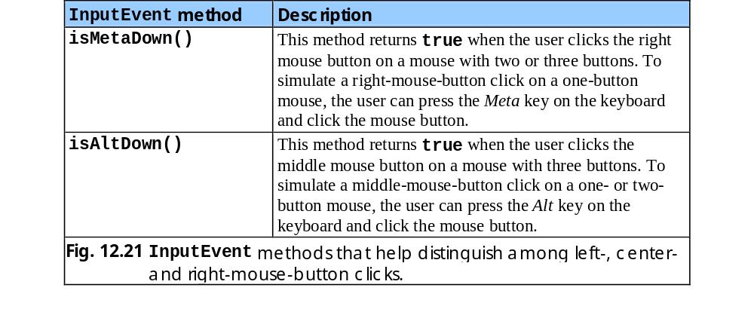
Fig. 12.21 InputEvent methods that help distinguish among left-, center- and right-mouse-button clicks.

Slide 63
12.22 Keyboard Event Handling
Interface KeyListener
  Handles key events
    Generated when keys on keyboard are pressed and released
    KeyEvent
      Contains virtual key code that represents key

Slide 64
1 // Fig. 12.22: KeyDemo.java
2 // Demonstrating keystroke events.
3
4 // Java core packages
5 import java.awt.*;
6 import java.awt.event.*;
7
8 // Java extension packages
9 import javax.swing.*;
10
11 public class KeyDemo extends JFrame implements KeyListener {
12 private String line1 = "", line2 = "";
13 private String line3 = "";
14 private JTextArea textArea;
15
16 // set up GUI
17 public KeyDemo()
18 {
19 super( "Demonstrating Keystroke Events" );
20
21 // set up JTextArea
22 textArea = new JTextArea( 10, 15 );
23 textArea.setText( "Press any key on the keyboard..." );
24 textArea.setEnabled( false );
25 getContentPane().add( textArea );
26
27 // allow frame to process Key events
28 addKeyListener( this );
29
30 setSize( 350, 100 );
31 setVisible( true );
32 }
33
34 // handle press of any key
35 public void keyPressed( KeyEvent event )
KeyDemo.java
Line 28
Line 35
Register JFrame for key events
Called when user presses key

Slide 65
36 {
37 line1 = "Key pressed: " +
38 event.getKeyText( event.getKeyCode() );
39 setLines2and3( event );
40 }
41
42 // handle release of any key
43 public void keyReleased( KeyEvent event )
44 {
45 line1 = "Key released: " +
46 event.getKeyText( event.getKeyCode() );
47 setLines2and3( event );
48 }
49
50 // handle press of an action key
51 public void keyTyped( KeyEvent event )
52 {
53 line1 = "Key typed: " + event.getKeyChar();
54 setLines2and3( event );
55 }
56
57 // set second and third lines of output
58 private void setLines2and3( KeyEvent event )
59 {
60 line2 = "This key is " +
61 ( event.isActionKey() ? "" : "not " ) +
62 "an action key";
63
64 String temp =
65 event.getKeyModifiersText( event.getModifiers() );
66
67 line3 = "Modifier keys pressed: " +
68 ( temp.equals( "" ) ? "none" : temp );
69
KeyDemo.java
Line 43
Lines 38 and 46
Line 51
Lines 64-65
Called when user releases key
Return virtual key code
Called when user types key
Determine if modifier keys (e.g., Alt, Ctrl, Meta and Shift) were used

Slide 66
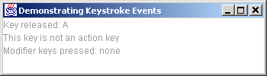





70 textArea.setText(
71 line1 + "\n" + line2 + "\n" + line3 + "\n" );
72 }
73
74 // execute application
75 public static void main( String args[] )
76 {
77 KeyDemo application = new KeyDemo();
78
79 application.setDefaultCloseOperation(
80 JFrame.EXIT_ON_CLOSE );
81 }
82
83 } // end class KeyDemo
KeyDemo.java

Slide 67
12.14 Layout Managers
Layout managers
  Provided for arranging GUI components
  Provide basic layout capabilities
  Processes layout details
  Programmer can concentrate on basic “look and feel”
  Interface LayoutManager

Slide 68

Fig. 12.23 Layout managers.

Slide 69
12.14.1 FlowLayout
FlowLayout
  Most basic layout manager
  GUI components placed in container from left to right

Slide 70
1 // Fig. 12.24: FlowLayoutDemo.java
2 // Demonstrating FlowLayout alignments.
3
4 // Java core packages
5 import java.awt.*;
6 import java.awt.event.*;
7
8 // Java extension packages
9 import javax.swing.*;
10
11 public class FlowLayoutDemo extends JFrame {
12 private JButton leftButton, centerButton, rightButton;
13 private Container container;
14 private FlowLayout layout;
15
16 // set up GUI and register button listeners
17 public FlowLayoutDemo()
18 {
19 super( "FlowLayout Demo" );
20
21 layout = new FlowLayout();
22
23 // get content pane and set its layout
24 container = getContentPane();
25 container.setLayout( layout );
26
27 // set up leftButton and register listener
28 leftButton = new JButton( "Left" );
29
30 leftButton.addActionListener(
31
32 // anonymous inner class
33 new ActionListener() {
34
35 // process leftButton event
FlowLayoutDemo.java
Lines 21-25
Set layout as FlowLayout

Slide 71
36 public void actionPerformed( ActionEvent event )
37 {
38 layout.setAlignment( FlowLayout.LEFT );
39
40 // re-align attached components
41 layout.layoutContainer( container );
42 }
43
44 } // end anonymous inner class
45
46 ); // end call to addActionListener
47
48 container.add( leftButton );
49
50 // set up centerButton and register listener
51 centerButton = new JButton( "Center" );
52
53 centerButton.addActionListener(
54
55 // anonymous inner class
56 new ActionListener() {
57
58 // process centerButton event
59 public void actionPerformed( ActionEvent event )
60 {
61 layout.setAlignment( FlowLayout.CENTER );
62
63 // re-align attached components
64 layout.layoutContainer( container );
65 }
66 }
67 );
68
69 container.add( centerButton );
70
FlowLayoutDemo.java
Line 38
Line 61
When user presses left JButton, left align components
When user presses center JButton, center components

Slide 72
71 // set up rightButton and register listener
72 rightButton = new JButton( "Right" );
73
74 rightButton.addActionListener(
75
76 // anonymous inner class
77 new ActionListener() {
78
79 // process rightButton event
80 public void actionPerformed( ActionEvent event )
81 {
82 layout.setAlignment( FlowLayout.RIGHT );
83
84 // re-align attached components
85 layout.layoutContainer( container );
86 }
87 }
88 );
89
90 container.add( rightButton );
91
92 setSize( 300, 75 );
93 setVisible( true );
94 }
95
96 // execute application
97 public static void main( String args[] )
98 {
99 FlowLayoutDemo application = new FlowLayoutDemo();
100
101 application.setDefaultCloseOperation(
102 JFrame.EXIT_ON_CLOSE );
103 }
104
105 } // end class FlowLayoutDemo
FlowLayoutDemo.java
Line 82
When user presses right JButton, right components

Slide 73





FlowLayoutDemo.java

Slide 74
12.14.2 BorderLayout
BorderLayout
  Arranges components into five regions
    NORTH (top of container)
    SOUTH (bottom of container)
    EAST (left of container)
    WEST (right of container)
    CENTER (center of container)

Slide 75
1 // Fig. 12.25: BorderLayoutDemo.java
2 // Demonstrating BorderLayout.
3
4 // Java core packages
5 import java.awt.*;
6 import java.awt.event.*;
7
8 // Java extension packages
9 import javax.swing.*;
10
11 public class BorderLayoutDemo extends JFrame
12 implements ActionListener {
13
14 private JButton buttons[];
15 private String names[] = { "Hide North", "Hide South",
16 "Hide East", "Hide West", "Hide Center" };
17 private BorderLayout layout;
18
19 // set up GUI and event handling
20 public BorderLayoutDemo()
21 {
22 super( "BorderLayout Demo" );
23
24 layout = new BorderLayout( 5, 5 );
25
26 // get content pane and set its layout
27 Container container = getContentPane();
28 container.setLayout( layout );
29
30 // instantiate button objects
31 buttons = new JButton[ names.length ];
32
33 for ( int count = 0; count < names.length; count++ ) {
34 buttons[ count ] = new JButton( names[ count ] );
35 buttons[ count ].addActionListener( this );
BorderLayoutDemo.java
Lines 24-28
Set layout as BorderLayout with 5-pixel horizontal and vertical gaps

Slide 76
36 }
37
38 // place buttons in BorderLayout; order not important
39 container.add( buttons[ 0 ], BorderLayout.NORTH );
40 container.add( buttons[ 1 ], BorderLayout.SOUTH );
41 container.add( buttons[ 2 ], BorderLayout.EAST );
42 container.add( buttons[ 3 ], BorderLayout.WEST );
43 container.add( buttons[ 4 ], BorderLayout.CENTER );
44
45 setSize( 300, 200 );
46 setVisible( true );
47 }
48
49 // handle button events
50 public void actionPerformed( ActionEvent event )
51 {
52 for ( int count = 0; count < buttons.length; count++ )
53
54 if ( event.getSource() == buttons[ count ] )
55 buttons[ count ].setVisible( false );
56 else
57 buttons[ count ].setVisible( true );
58
59 // re-layout the content pane
60 layout.layoutContainer( getContentPane() );
61 }
62
63 // execute application
64 public static void main( String args[] )
65 {
66 BorderLayoutDemo application = new BorderLayoutDemo();
BorderLayoutDemo.java
Lines 39-43
Lines 54-57
Place JButtons in regions specified by BorderLayout
When JButtons are “invisible,” they are not displayed on screen, and BorderLayout rearranges

Slide 77



67
68 application.setDefaultCloseOperation(
69 JFrame.EXIT_ON_CLOSE );
70 }
71
72 } // end class BorderLayoutDemo
BorderLayoutDemo.java

Slide 78


BorderLayoutDemo.java

Slide 79
12.14.3 GridLayout
GridLayout
  Divides container into grid of specified row an columns
  Components are added starting at top-left cell
    Proceed left-to-fight until row is full

Slide 80
1 // Fig. 12.26: GridLayoutDemo.java
2 // Demonstrating GridLayout.
3
4 // Java core packages
5 import java.awt.*;
6 import java.awt.event.*;
7
8 // Java extension packages
9 import javax.swing.*;
10
11 public class GridLayoutDemo extends JFrame
12 implements ActionListener {
13
14 private JButton buttons[];
15 private String names[] =
16 { "one", "two", "three", "four", "five", "six" };
17 private boolean toggle = true;
18 private Container container;
19 private GridLayout grid1, grid2;
20
21 // set up GUI
22 public GridLayoutDemo()
23 {
24 super( "GridLayout Demo" );
25
26 // set up layouts
27 grid1 = new GridLayout( 2, 3, 5, 5 );
28 grid2 = new GridLayout( 3, 2 );
29
30 // get content pane and set its layout
31 container = getContentPane();
32 container.setLayout( grid1 );
33
34 // create and add buttons
35 buttons = new JButton[ names.length ];
GridLayoutDemo.java
Line 27
Line 28
Create GridLayout grid1 with 2 rows and 3 columns
Create GridLayout grid2 with 3 rows and 2 columns

Slide 81
36
37 for ( int count = 0; count < names.length; count++ ) {
38 buttons[ count ] = new JButton( names[ count ] );
39 buttons[ count ].addActionListener( this );
40 container.add( buttons[ count ] );
41 }
42
43 setSize( 300, 150 );
44 setVisible( true );
45 }
46
47 // handle button events by toggling between layouts
48 public void actionPerformed( ActionEvent event )
49 {
50 if ( toggle )
51 container.setLayout( grid2 );
52 else
53 container.setLayout( grid1 );
54
55 toggle = !toggle; // set toggle to opposite value
56 container.validate();
57 }
58
59 // execute application
60 public static void main( String args[] )
61 {
62 GridLayoutDemo application = new GridLayoutDemo();
63
64 application.setDefaultCloseOperation(
65 JFrame.EXIT_ON_CLOSE );
66 }
67
68 } // end class GridLayoutDemo
GridLayoutDemo.java
Lines 50-53
Toggle current GridLayout when user presses JButton

Slide 82


GridLayoutDemo.java

Slide 83
12.15 Panels
Panel
  Helps organize components
  Class JPanel is JComponent subclass
  May have components (and other panels) added to them

Slide 84
1 // Fig. 12.27: PanelDemo.java
2 // Using a JPanel to help lay out components.
3
4 // Java core packages
5 import java.awt.*;
6 import java.awt.event.*;
7
8 // Java extension packages
9 import javax.swing.*;
10
11 public class PanelDemo extends JFrame {
12 private JPanel buttonPanel;
13 private JButton buttons[];
14
15 // set up GUI
16 public PanelDemo()
17 {
18 super( "Panel Demo" );
19
20 // get content pane
21 Container container = getContentPane();
22
23 // create buttons array
24 buttons = new JButton[ 5 ];
25
26 // set up panel and set its layout
27 buttonPanel = new JPanel();
28 buttonPanel.setLayout(
29 new GridLayout( 1, buttons.length ) );
30
31 // create and add buttons
32 for ( int count = 0; count < buttons.length; count++ ) {
33 buttons[ count ] =
34 new JButton( "Button " + ( count + 1 ) );
35 buttonPanel.add( buttons[ count ] );
PanelDemo.java
Line 27
Line 35
Create JPanel to hold JButtons
Add JButtons to JPanel

Slide 85

36 }
37
38 container.add( buttonPanel, BorderLayout.SOUTH );
39
40 setSize( 425, 150 );
41 setVisible( true );
42 }
43
44 // execute application
45 public static void main( String args[] )
46 {
47 PanelDemo application = new PanelDemo();
48
49 application.setDefaultCloseOperation(
50 JFrame.EXIT_ON_CLOSE );
51 }
52
53 } // end class PanelDemo
PanelDemo.java
Line 38
Add JPanel to SOUTH region of Container

Slide 86
12.12 (Optional Case Study) Thinking About Objects: Use Cases
Use case
  Represents capabilities that systems provide to clients
    Automated-teller-machine use cases
      “Deposit Money,” “Withdraw Money,” “Transfer Funds”

Slide 87
12.12 Thinking About Objects (cont.)
Use-case diagram
  Models use cases in system
  Facilitates system-requirements gathering
  Notation
    Stick figure represents actor
      Actor represents set of roles that external entity can play
    System box (rectangle) contains system use cases
    Ovals represent use cases

Slide 88
12.12 Thinking About Objects (cont.)
Elevator-simulation use cases
  “Create Person”
    From user’s perspective
  “Relocate Person” (move to other floor)
    From Person’s perspective
Constructing GUI
  Use “Create Person” use case

Slide 89

Fig. 12.28 Use-case diagram for elevator simulation from user’s perspective

Slide 90

Fig. 12.28 Use-case diagram from the perspective of a Person

Slide 91
1 // ElevatorController.java
2 // Controller for Elevator Simulation
3 package com.deitel.jhtp4.elevator.controller;
4
5 // Java core packages
6 import java.awt.*;
7 import java.awt.event.*;
8
9 // Java extension packages
10 import javax.swing.*;
11
12 // Deitel packages
13 import com.deitel.jhtp4.elevator.model.*;
14 import com.deitel.jhtp4.elevator.event.*;
15 import com.deitel.jhtp4.elevator.ElevatorConstants;
16
17 public class ElevatorController extends JPanel
18 implements ElevatorConstants {
19
20 // controller contains two JButtons
21 private JButton firstControllerButton;
22 private JButton secondControllerButton;
23
24 // reference to model
25 private ElevatorModel elevatorModel;
26
27 public ElevatorController( ElevatorModel model )
28 {
29 elevatorModel = model;
30 setBackground( Color.white );
31
32 // add first button to controller
33 firstControllerButton = new JButton( "First Floor" );
34 add( firstControllerButton );
35
ElevatorController.java
Line 17
Lines 21-22
ElevatorController GUI for elevator simulation
JButtons for creating Persons on Floor

Slide 92
36 // add second button to controller
37 secondControllerButton = new JButton( "Second Floor" );
38 add( secondControllerButton );
39
40 // anonymous inner class registers to receive ActionEvents
41 // from first Controller JButton
42 firstControllerButton.addActionListener(
43 new ActionListener() {
44
45 // invoked when a JButton has been pressed
46 public void actionPerformed( ActionEvent event )
47 {
48 // place Person on first Floor
49 elevatorModel.addPerson(
50 FIRST_FLOOR_NAME );
51
52 // disable user input
53 firstControllerButton.setEnabled( false );
54 }
55 } // end anonymous inner class
56 );
57
58 // anonymous inner class registers to receive ActionEvents
59 // from second Controller JButton
60 secondControllerButton.addActionListener(
61 new ActionListener() {
62
63 // invoked when a JButton has been pressed
64 public void actionPerformed( ActionEvent event )
65 {
66 // place Person on second Floor
67 elevatorModel.addPerson(
68 SECOND_FLOOR_NAME );
69
70 // disable user input
ElevatorController.java
Lines 42-43 and 60-61
Lines 49-50 and 67-68
Line 53 and 71
Register JButtons with separate anonymous ActionListeners
Add Person to respective Floor, depending on JButton that user pressed
Disable JButton after Person is created (so user cannot create more than one Person on Floor)

Slide 93
71 secondControllerButton.setEnabled( false );
72 }
73 } // end anonymous inner class
74 );
75
76 // anonymous inner class enables user input on Floor if
77 // Person enters Elevator on that Floor
78 elevatorModel.addPersonMoveListener(
79 new PersonMoveListener() {
80
81 // invoked when Person has entered Elevator
82 public void personEntered(
83 PersonMoveEvent event )
84 {
85 // get Floor of departure
86 String location =
87 event.getLocation().getLocationName();
88
89 // enable first JButton if first Floor departure
90 if ( location.equals( FIRST_FLOOR_NAME ) )
91 firstControllerButton.setEnabled( true );
92
93 // enable second JButton if second Floor
94 else
95 secondControllerButton.setEnabled( true );
96
97 } // end method personEntered
98
99 // other methods implementing PersonMoveListener
100 public void personCreated(
101 PersonMoveEvent event ) {}
102
103 public void personArrived(
104 PersonMoveEvent event ) {}
105
ElevatorController.java
Lines 78-79
Lines 90-95
Enable ElevatorModel to listener for PersonMoveEvents
Enable JButton after Person enters Elevator (so user can create another Person)

Slide 94
106 public void personExited(
107 PersonMoveEvent event ) {}
108
109 public void personDeparted(
110 PersonMoveEvent event ) {}
111
112 public void personPressedButton(
113 PersonMoveEvent event ) {}
114
115 } // end anonymous inner class
116 );
117 } // end ElevatorController constructor
118 }
ElevatorController.java

Slide 95
1 // ElevatorConstants.java
2 // Constants used between ElevatorModel and ElevatorView
3 package com.deitel.jhtp4.elevator;
4
5 public interface ElevatorConstants {
6
7 public static final String FIRST_FLOOR_NAME = "firstFloor";
8 public static final String SECOND_FLOOR_NAME = "secondFloor";
9 public static final String ELEVATOR_NAME = "elevator";
10 }
ElevatorConstants.java
Lines 7-9
Classes use these constants to refer to Locations

Slide 96
12.12 Thinking About Objects (cont.)
Classes Location
  Subclasses Elevator and Floor
    Attribute capacity no longer needed

Slide 97

Fig. 12.32 Modfied class diagram showing generalization of superclass Location and subclasses Elevator and Floor.

